Slide 1
Patient Facility Representative (PFR) Alliance Meeting
December 7, 2023

Slide 2
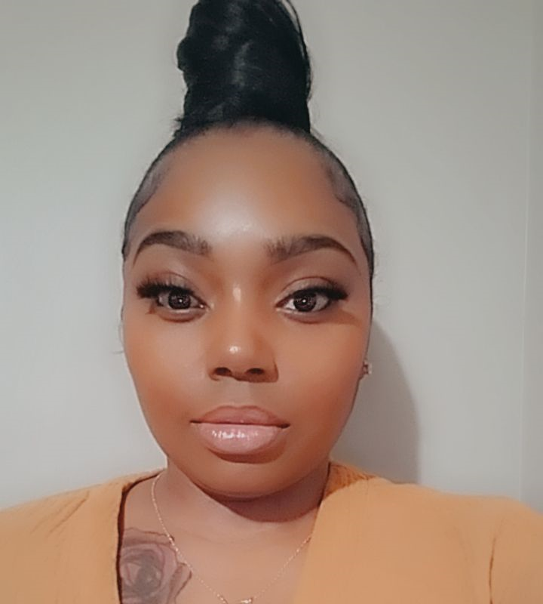
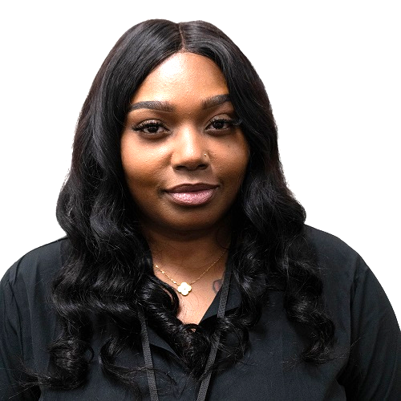
Patient and Family Engagement Facilitators
Aisha Edmondson
Patient Family Engagement Lead

Slide 3
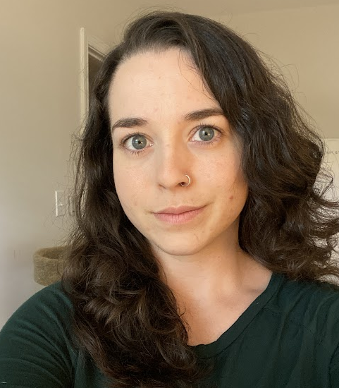
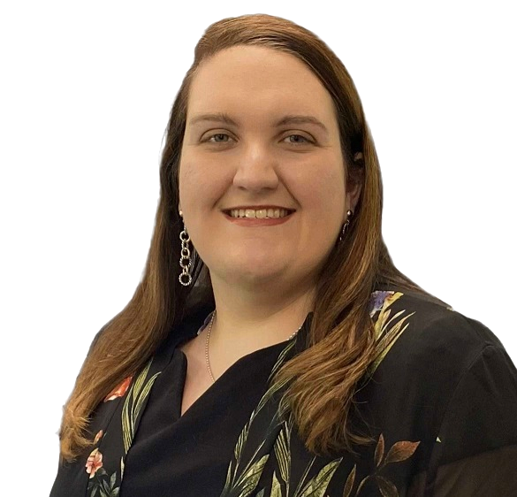
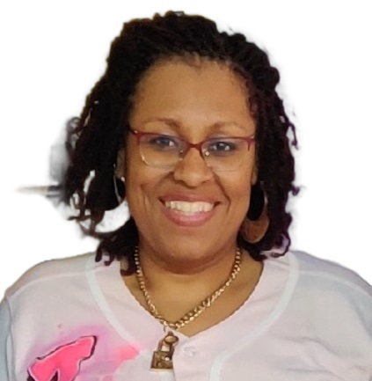
Patient and Family Engagement Facilitators
Stephanie Cole, BA, PSM, QP
Community Outreach Specialist
Brooke Andrews, MSW
Patient Services Speaker
Tiffany Reese-Arrington, CCHT
Quality Improvement Speaker

Slide 4
Today’s Agenda
Topics for Review/Discussion
Meeting Reminders
Patient Services Topic
PFR Check-In
Closing Remarks
Quality Improvement Topic

Slide 5
Meeting Reminders
All phone lines are muted upon entry to eliminate background noise/distractions
We will be monitoring Chat throughout the meeting for questions or comments
All slides will be shared within a week of completion of the meeting

Slide 6
Please Welcome Our New Members!
Debra Wighaman
Denise Truitt
David Hawthorne
Charmaine Blount
Annette Gatewood
Tina James
Eric Hall
Shirlee Wing
Todd Rock
Retha Powell
Jamie Chapman
Mary Didion
Samantha Fordham
Aunya Johnson
Tomeka Jones
Vera Guarino
Pascual Meletiche
Philip Corker
Angela Davis
Christopher Riddle
Paula Esper
Janet Costa
Patricia Hawkins
Paula Fortenberry
Tasha Augustin
Mark Hammond
Christopher Wright
Mary Martin
Elizabeth Carter

Slide 7
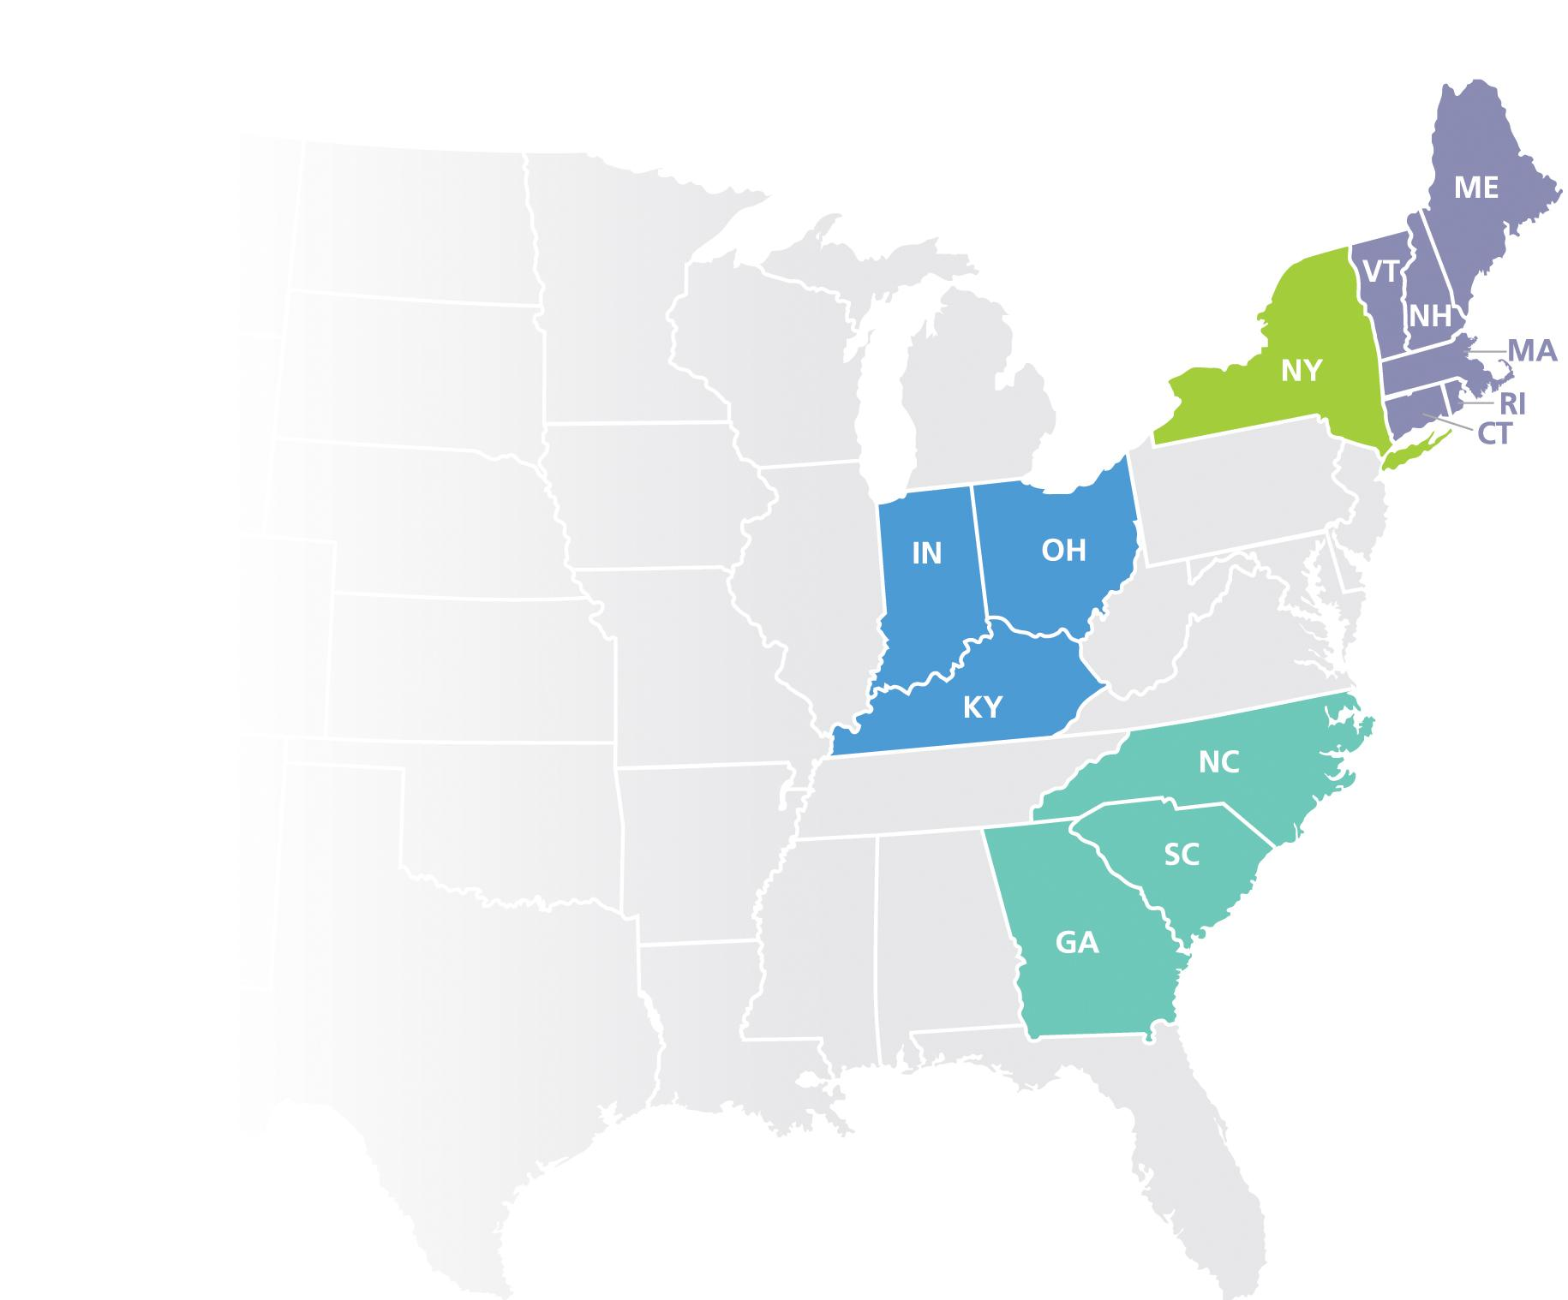
IPRO ESRD Network Program
The IPRO End-Stage Renal Disease Network Program includes four ESRD Networks:
Network 1: ESRD Network of New England
Network 2: ESRD Network of New York
Network 6: ESRD Network of the South Atlantic
Network 9: ESRD Network of the Ohio River Valley
The mission of the IPRO End-Stage Renal Disease Network Program is to promote healthcare for all ESRD patients that is safe, efficient,patient-centered, timely, and equitable.

Slide 8
Network Check-In
Polling Question
Which Network are you from?
Network 1 (Connecticut, Massachusetts, Maine, New Hampshire, Rhode Island, Vermont)
Network 2 (New York)
Network 6 (North Carolina, South Carolina, Georgia)
Network 9 (Indiana, Kentucky, Ohio)

Slide 9
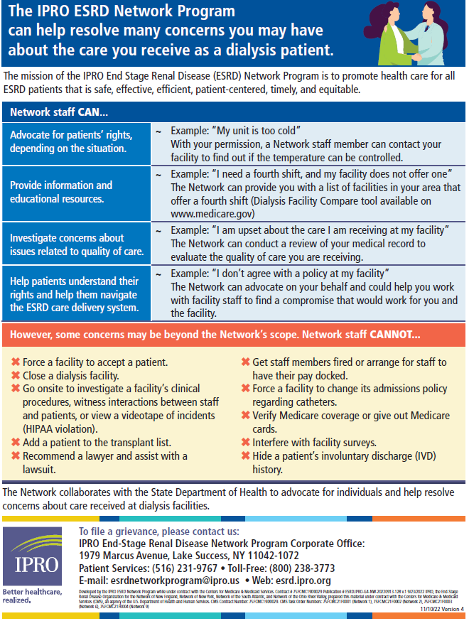
The Network’s Role
What the Network’s staff CAN and CANNOT do
Network staff CAN…
Advocate for patients’ rights, depending on the situation.
Provide information and educational resources.
Investigate concerns about issues related to quality of care.
Help patients understand their rights and help them navigate
the ESRD care delivery system.
Network staff CANNOT...
Force a facility to accept a patient.
Close a dialysis facility.
Go onsite to investigate a facility’s clinical procedures, witness interactions
between staff and patients, or view a videotape of incidents (HIPAA violation).
Add a patient to the transplant list.
Recommend a lawyer and assist with a lawsuit.
Get staff members fired or arrange for staff to have their pay docked.
Force a facility to change its admissions policy regarding catheters.
Verify Medicare coverage or give out Medicare cards.
Interfere with facility surveys.
Hide a patient’s involuntary discharge (IVD) history.

Slide 10
Effective Communication
Brooke Andrews, MSW
Patient Services Specialist

Slide 11
Network Check-In
Polling Question
Do you feel like your clinic communicates effectively with you?
Yes
No
Unsure

Slide 12
Network Check-In
Polling Question
What are the most common ways to communicate?
Spoken words
Visual images
Written words
Body language
All of the above
Unsure

Slide 13
Network Check-In
Polling Question
As a PFR how do you support other patients in the dialysis center?
Enter your answer into the chat box

Slide 14
Communication Starts with You
Communication is the process of transferring signals/messages between a sender and a receiver through various methods (written words, nonverbal cues, spoken words). It is also the mechanism we use to establish and modify relationships.
Communicate at clinic level first
Internal Grievance Process

Slide 15
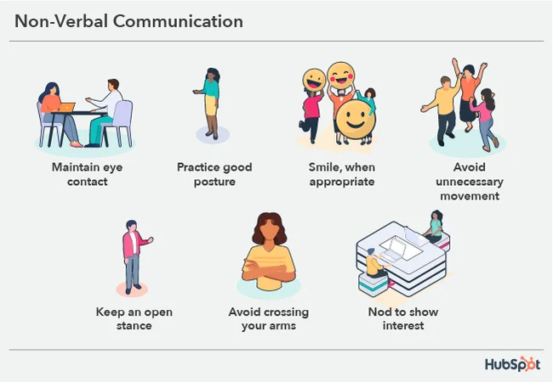
Ways We Communicate
Engaging your audience
Make eye contact
Self Awareness of what message your body is conveying
NOT clearly making judgments or assumptions
Utilizing good listening skills and to show we care
Speak clearly and slowly
Requesting feedback to be sure what you have said is understood

Slide 16
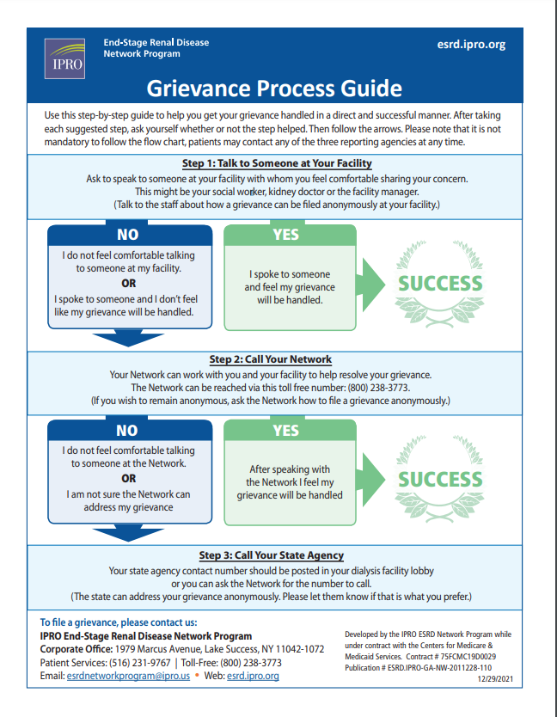
Network Resources
Patient Rights and Responsibilities
Grievance Process Flyer

Slide 17
Healthy Living BINGO!!!
Tiffany Reese-Arrington, CCHT
Project Lead, Healthy Lifestyles

Slide 18
Network Check-In
Polling Question
Does your facility incorporate fun activities?
Yes
No
Unsure

Slide 19
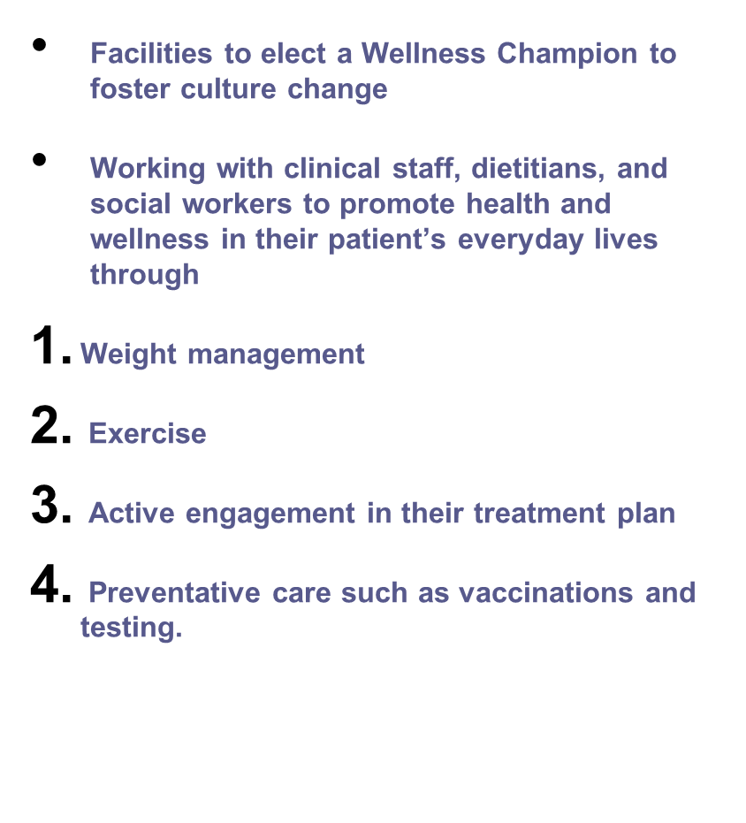
Healthy Living Initiative
Objective
Focusing on the optimal health of each patient while incorporating preventative measures to help patients manage their comorbid conditions better.
Notes:
Slide Healthy Living Initiative -
Currently the Goal of CMS is the focus on increasing vaccinations within the ESRD population, but while CMS strives to develop guidelines around weight reduction/obesity/BMI metrics the network wants to increase the awareness around the Healthy Living initiative.
Focusing on the overall health of ESRD patients while incorporating preventative measures to manage comorbidities. We want to continue encourage patients to develop relationships with a PCP so that there is trust within the healtcare system and increase positive trends in necessary testing and vaccinations.

Slide 20
Game Key Points!
What
How
Fun, interactive approach to bring awareness on ways to maintain a healthy lifestyle
Engages and promotes health literacy
Inclusive of all areas of health including access care, weight management, prevention measures, etc.
Increase in clinic morale for ALL and help in other metrics
Can be played both virtually and live
Bingo Cards, Key Sheet, and PowerPoint is provided
Include the Healthy Living Champion and/or IDT to help facilitate
Can be played in Home and ICHD
Notes:
What is it? - It's a fun, interactive approach to bring awareness of all aspects of healthy living to our population. It's a tool that will not only engage the audience but will promote health literacy. Definitions are inclusive of terms related to types of accesses and how to care for them, ways and methods to manage weight (whether its to reduce or gain weight), individuals apart of your care team and even preventative measures to help manage End Stage Renal Disease.
How will it work? - Bingo can be played both virtually and live so the ability to participate is available anytime. IPRO will provide materials for the game including 10 Bingo cards, the key sheet which will include images of definition and term, and a powerpoint slide deck to play online. perfect time for Wellness or Healthy Living Champion make a debut and again if unable to nominate a single individual, colloborate with IDT to help facilitiate. And game can be played In-center and within Home dept (online and maybe live if your facility offers support groups or group trainings)

Slide 21
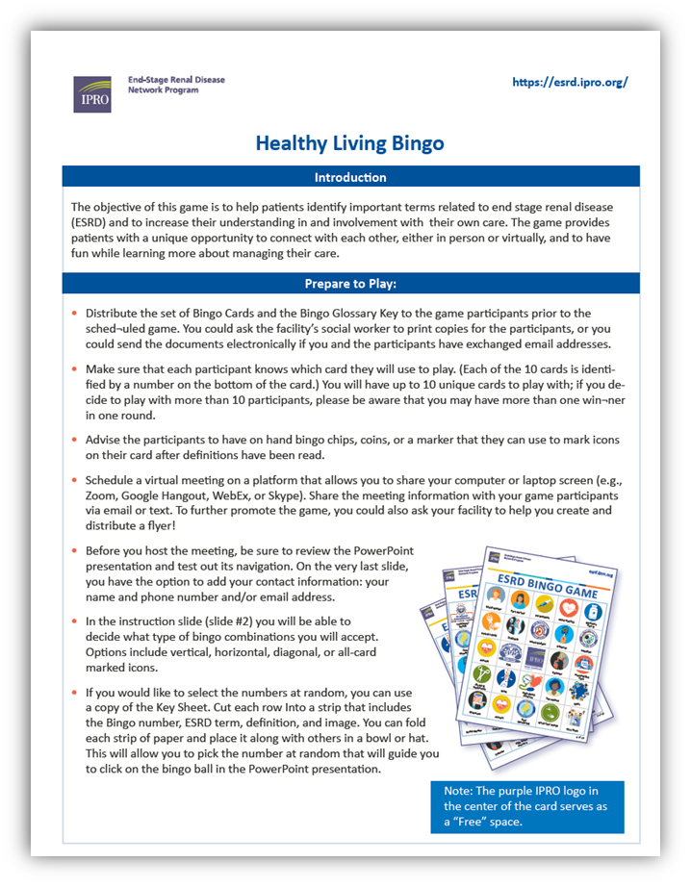
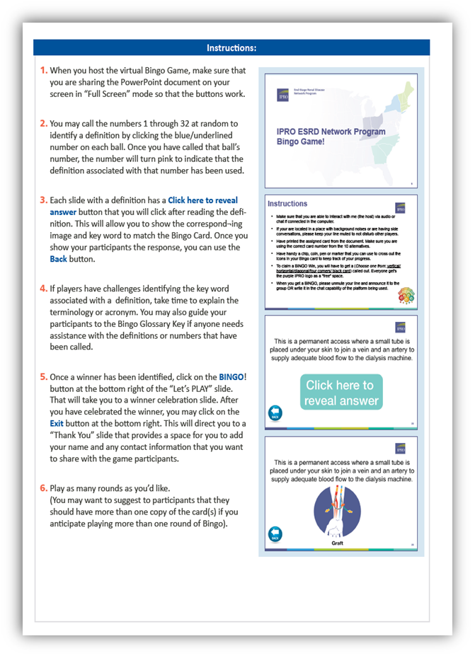
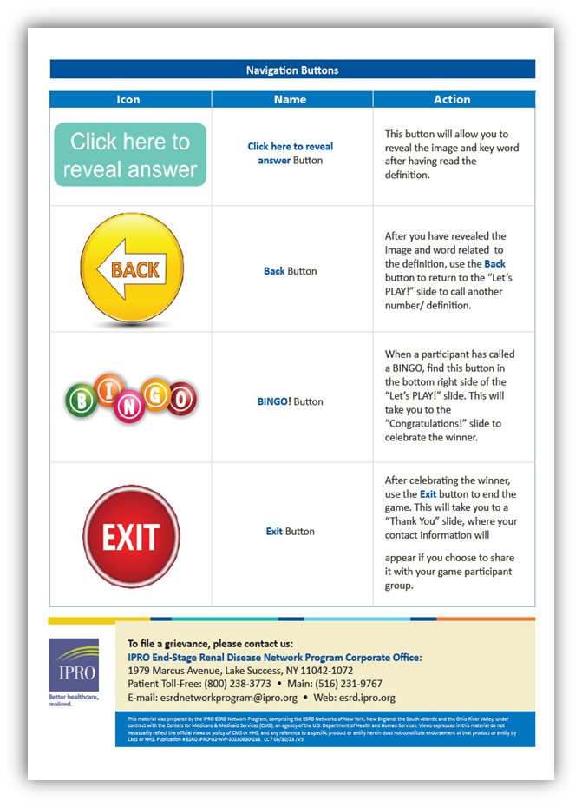
Resource Highlights
BINGO
Notes:
his is a screen shot of the Healthy Living Bingo Key sheet thats apart of the packet. Page 1 provides an introducton on the objective of game, and then proceeeds to explain on how to prepare to play. Just to touch on a few highlights:
1. On the bottom right hand side of page 1 you will notice a pix of the bingo cards and what the images look like. This is what your participants will utilize during the game. Please be mindful that there are 10 specific cards and they are all numbered, so if you plan to play with more than 10 people, be prepared to have more than1 winner.
2. Although, we are providing the bingo packet, paticipants will need some sort of marker: bingo chips, change or some sort of writing material like a pen, pencil or marker. please be advised It's not necessary to go out and purchase branded Bingo markers, colored dab ink markers or bingo chips, use what you have in house including piecees of shredded paper.
3. Schedule your game accordingly. You want to build up the hype so post flyers, get your team to talk about it on txt floors, involve your PFR's. Whether you do it in person or online, word of mouth is the best method of promoting something.
4. Before you begin, make sure everything is in alignment: you want to make sure the PP opens and navigation buttons are functionable, your virtual platform is setup (zoom, webex, skype, google hangout)
Lastly, this is a key tine to determine the rules of the game. While many are aware on how to play, you can assume so make sure you clarify if your allowing all wins (i.e. horizontal, vertical, diagonal, four corners, or black out
On page 2, the instructions are provided along with screenshots of the powerpoint slide deck and what to look for and the third page gives a description on the Navigation buttons.

Slide 22
Notes:
So lets play, Im going to give a live demonstration on how to play virtually. As you can see there are a total of 32 definitions, you can opt to randomly pick and click on a number. For this demonstration, I will choose 12.

Slide 23
Your choices about what to eat and drink while on dialysis can make a difference in how you feel and can make treatments work better.
Notes:
The person facilitating will then read the definition (read definition out loud)

Slide 24
Notes:
and players will choose an image on their card with the term.

Slide 25
Your choices about what to eat and drink while on dialysis can make a difference in how you feel and can make treatments work better.
Notes:
When ready, click button to reveal and image will disiplay.

Slide 26
Possible Barriers
Ways to Mitigate
Time – downtime, advertise and schedule, play online
Language – bilingual staff, Interpreter devices
Engagement – Bragging Rights, Incentivize
Staffing – utilize all (RN’s, Techs, IDT, PFR)
Clinic Floor/Set-up – Project using clinic resources (TV’s, Intercoms, staff)

Slide 27
Next Steps
Aisha Edmondson
Patient and Family Engagement

Slide 28
Next Steps
Follow us on social media!
Join the PFR Alliance Facebook Group https://www.facebook.com/groups/ipropfralliance
Create your IPRO Learn Account https://esrd.iprolearn.org/login/index.php/
Participate in a call with Network staff and CMS to share your experience as a PFR, address issues impacting your facility and peers, and offer recommendations on how to improve patient care - volunteers needed each month!
Become a Peer Mentor:
○ Understand the steps https://esrd.ipro.org/patients-family/pfe/peer-mentoring/
○ Sign up to become a peer mentor!
○ Have questions?
Review the Frequently Asked Questions resource https://esrdncc.org/globalassets/peer-mentoring-operational-toolkit/14pmlmsfaq508 .pdf
Contact Aisha Edmondson at (216)755-3056 or Stephanie Cole (919) 928-6042

Slide 29
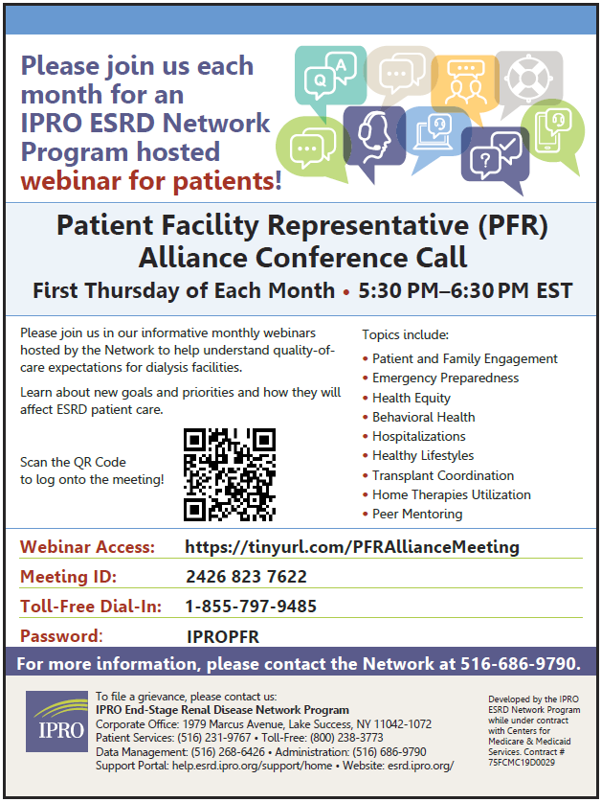
Next PRF Meeting - Mark Your Calendar!
Thursday, January 4th 2023 at 5:30pm ET
Upcoming Topics: How Old is to Old for
Home Dialysis?
Emergency Preparedness
Things to Think About: What information
would you like to discuss and how can we
make it fun and interactive!!

Slide 30
Community Awareness Campaigns
December is National Handwashing Awareness Week (December 5-11) National Influenza Vaccination Week (December 4–8)
Together, we can take steps to improve health in communities nationwide!
1. Wash your hands when they are dirty and before eating.
2. DO NOT cough into your hands.
3. DO NOT sneeze into your hands.
4. DO NOT put your fingers into your eyes, nose or mouth.

Slide 31
https://www.facebook.com/IPRO.ESRDNetworkPgm

Slide 32
Social Media
Follow Us!
IPRO ESRD Network Program’s Facebook Page
IPRO ESRD Patient Facility Representative (PFR) Alliance Group
IPRO ESRD Network Program’s Twitter Page
IPRO ESRD Network Program’s Linkedin Page
IPRO ESRD Network Program’s Instagram

Slide 33
Questions?
Comments?

Slide 34
Thank you for your ongoing commitment to the ESRD community!
For more information, contact:
Aisha Edmondson
Project Manager: Patient Family Engagement Tel: 216-755-3066| E-mail: aedmondson@ipro.org
Stephanie Cole, BA, PSM, QP
Project Manager: Community Outreach Specialist
Tel: (919) 928-6042 | E-mail: scole@ipro.org

