Slide 1
Healthy Living Bingo Game!

Slide 2
Instructions
Make sure that you are able to interact with me (the host) via audio or chat when connected through the computer.
Please mute your line if you are in a place with background noises or are having side conversations.
Print out the numbered card that was assigned to you.
Make sure you have coins or chips that you can use to mark out the images in your Bingo card as they are called out.
To claim a BINGO Win, you must have images on your card marked out either vertically, horizontally, or diagonally; or you could have each of the four corners, or the complete card crossed out.
When you get a BINGO, please unmute your line and announce it to the group OR write it in the chat.

Slide 3
Let’s PLAY!

Slide 4
Let’s PLAY!
1
2
3
4
5
6
7
8
9
10
11
12
13
14
15
16
17
18
19
20
21
22
23
24
25
26
27
28
29
30
31
32

Slide 5
Definitions & Images

Slide 6
This (usually a shot) protects you from serious and sometimes deadly diseases. You should take the recommended ones to build immunity to diseases like the flu and hepatitis B.
Click here to reveal answer

Slide 7
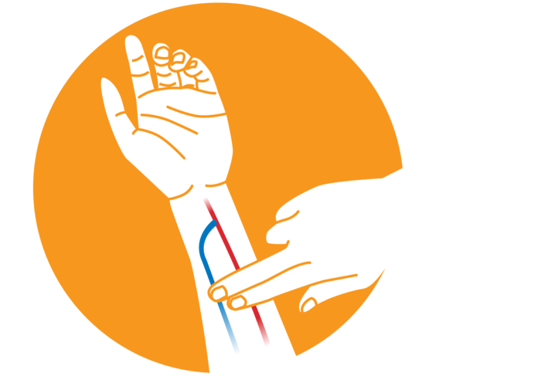
This is a vibration felt over the fistula. Check morning and night using two fingers over your fistula to feel the motion of the blood flowing through it. This shows that your access is working. Report any changes to your dialysis team.
Click here to reveal answer

Slide 8
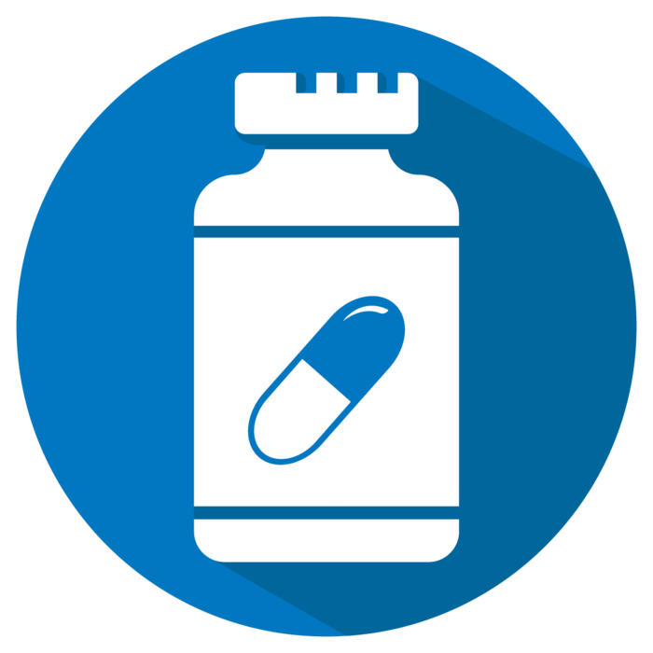
This prescription drug benefit helps cover the costs of most outpatient prescription drugs. This is offered through private companies as a stand-along plan (if you have Original Medicare) or as set of benefits included with a Medicare Advantage Plan.
Click here to reveal answer

Slide 9
A focused approach to improve quality and safety for all patients in your clinic. It brings together members of the dialysis team in monthly meetings to work together to find creative solutions to quality and safety issues. These meetings include all members of your clinic’s professional dialysis team (dietitians, social workers, nurses, physicians); clinic management; and patient representatives.
Click here to reveal answer

Slide 10
This group includes the individuals who provide you with support and assistance to make sure that you get the care you need during your dialysis journey. Members may include your nephrologist, kidney educator, nurse, patient care technician, dietitian, social worker, peer mentor, and others. Talk to any member if you are feeling depressed or having a hard time adjusting to life with dialysis.
Click here to reveal answer

Slide 11
Routine health care procedures that include screenings, check-ups, vaccinations, and patient counseling to prevent or slow the progression of illnesses, diseases, or other health problems.
Click here to reveal answer

Slide 12
Your choices about what to eat and drink while on dialysis can make a difference in how you feel and can make treatments work better.
Click here to reveal answer

Slide 13
This provides a number of health benefits, both physical and emotional. Benefits include improved heart function, stronger bones and muscles, improvement in doing everyday activities and improvement in your emotional state.
Click here to reveal answer

Slide 14
If there is a life-threatening emergency while you are on the dialysis machine, you should learn this procedure to safely disconnect yourself from the machine. This procedure should be used only if you have a fistula. If you have a catheter wait for a member of the healthcare team to disconnect you from the machine.
Click here to reveal answer

Slide 15
A common and treatable condition in which your red blood cell levels are low. If you have this, your body does not get enough oxygen-rich blood, and you may feel tired, weak, and short of breath.
Click here to reveal answer

Slide 16
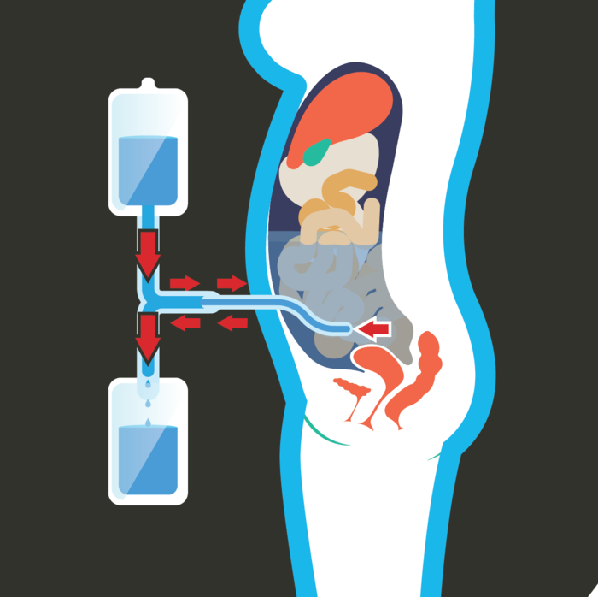
This fluid is prescribed by your doctor, and it is used to remove waste products from the blood during dialysis.
Click here to reveal answer

Slide 17
These are funded by the federal government to ensure that appropriate, quality care is provided to individuals who receive treatment through Medicare-certified dialysis facilities and kidney transplant centers. If you have a concern about the quality of care you ae receiving or an issue with accessing care, you can call:
In New England: 1-866-286-3773
In GA, NC, or SC: 1-800-524-7139
In KY, IN, or OH: 1-844-819-3010
In NY: 1-800-228-3773
Click here to reveal answer

Slide 18
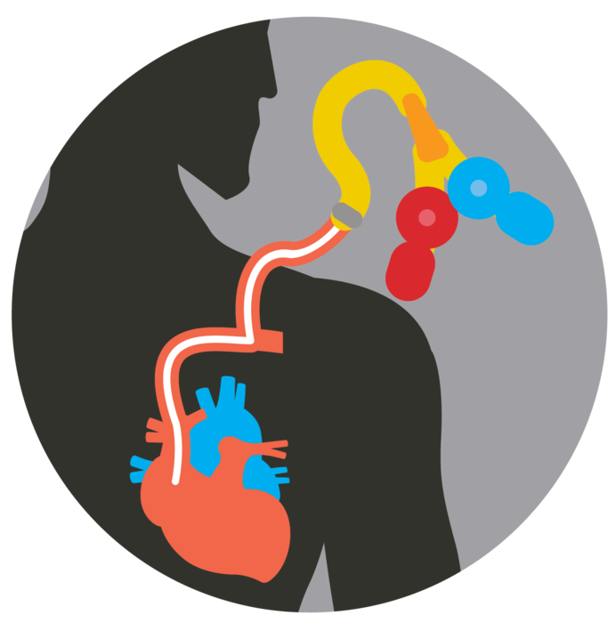
For hemodialysis to take place, access to a vein is needed to move blood between your body and the dialysis machine. This access created by inserting a tube through the skin, in a vein, in the neck, chest or groin. The tip of the tube ends near the heart. These are often placed for short-term use and can be placed quickly. This type of access is associated with a high rate of infection.
Click here to reveal answer

Slide 19
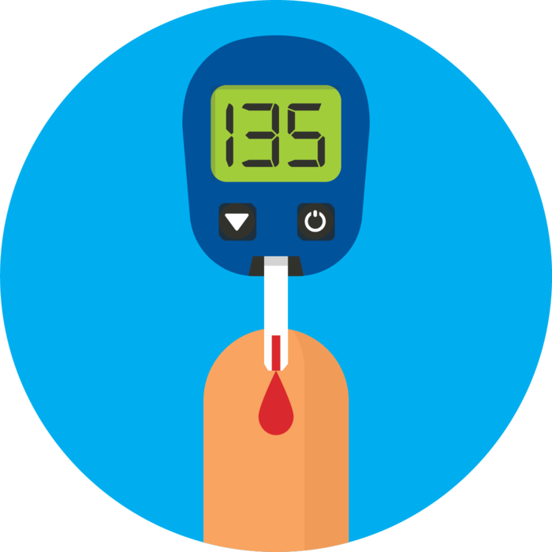
A chronic condition that affects how your body turns food into energy. Insulin is a hormone made by the pancreas that helps glucose (sugar) get into your cells to be used for energy. If you have this disease, your body doesn’t make enough – or any – insulin, or doesn’t use insulin properly, which leads to having too much blood sugar in your bloodstream.
Click here to reveal answer

Slide 20
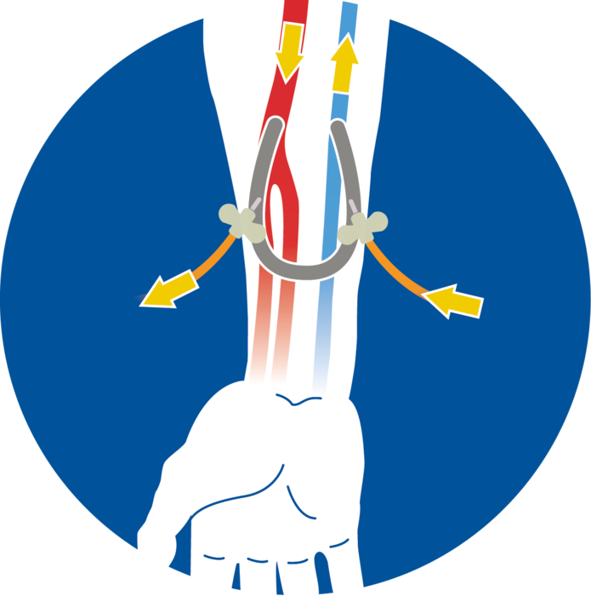
For hemodialysis to take place, access to a vein is needed to move blood between your body and the dialysis machine. An arteriovenous (AV) one of these is created by connecting a vein to an artery using a soft plastic tube. After it heals, hemodialysis is performed by placing one needle in the arterial side and one in the venous side of the AV.
Click here to reveal answer

Slide 21
Also called hypertension, this when the force of your blood pushing against the walls of your blood vessels is consistently too high. This causes the heart to pump harder and can lead to heart disease, kidney disease, or stroke.
Click here to reveal answer

Slide 22
This is the best defense against the spread of disease.
Click here to reveal answer

Slide 23
This role serves as a primary member of your care team and to advocate for yourself to make sure you are receiving quality care.
Click here to reveal answer

Slide 24
A trained professional who provides support to patients and their families, discusses treatment goals and goals for life outside of dialysis. Talk to them if you are feeling depressed or having a hard time adjusting to life with dialysis.
Click here to reveal answer

Slide 25
A person with two healthy kidneys who donates one of his/her organs for transplantation to another person.
Click here to reveal answer

Slide 26
A person who provides emotional and physical support to a loved one during their health journey with end stage renal disease.
Click here to reveal answer

Slide 27
A written, verbal, or electronic request for a formal investigation of a concern or complaint about your dialysis facility. If possible, this should first be discussed with a member of your facility’s management team. If that approach is not comfortable or successful, you should contact your ESRD Network or your state’s survey agency.
Click here to reveal answer

Slide 28
Services offered to persons to assist them in gaining employment or going back to school.
Click here to reveal answer

Slide 29
The invasion and growth of germs (bacteria, virus, fungus, etc) in the body. This can cause fever, redness, swelling, pus, pain, and/or confusion.
Click here to reveal answer

Slide 30
For hemodialysis to take place, access to a vein is needed to move blood between your body and the dialysis machine. This is a direct connection, made by a vascular surgeon, of an artery to a vein. Once, created, it is a natural party of the body. These are considered to be the “gold standard” of vascular access.
Click here to reveal answer

Slide 31
A treatment option in which an organ is replaced with a healthy organ from a living or deceased donor.
Click here to reveal answer

Slide 32
An organized group of patients and/or family members who volunteer their time to represent the ESRD Network in their dialysis or transplant facility, and also represent their facility to the ESRD Network.
Click here to reveal answer

Slide 33
An interaction between a person who has a lived experience in a topic and is willing to share knowledge gained through their experience to guide and support someone new to that experience.
Click here to reveal answer

Slide 34
A treatment option for which you receive specialized training to perform dialysis in the comfort of your home.
Click here to reveal answer

Slide 35
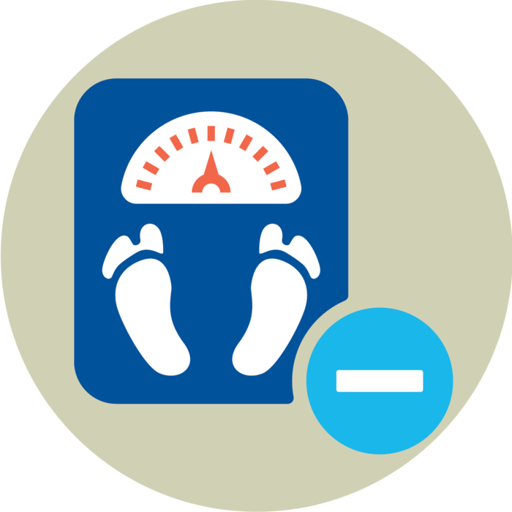
Can improve mobility, help with comorbid conditions such a diabetes and hypertension and can improve sleep and boost your energy.
Click here to reveal answer

Slide 36
Refers to the lifestyle that includes regular exercise and healthy diet to improve heart health and blood pressure.
Click here to reveal answer

Slide 37
This person offers you important support to help you better understand what you need to do to stay healthy. They can catch potential problems early, before they become serious or life threatening; know when you need more advanced care; and will refer you to specialists they trust.
Click here to reveal answer

Slide 38
CONGRATULATIONS!

Slide 39
Thank you for playing!
As Applicable
Your personal or local
Contact info here: trarrington@ipro.org

