Slide 1


HEALTHY LIVING

Slide 2

Game A – Holistic Care
Categories
Nutritional Wellness
Physical Activity
Healthy Choices
Play Game
A

Slide 3
Let’s PLAY!
Instructions
Online play
Make sure that you can interact with me (the host) via audio or chat when connected through the computer
Please mute your line if you are in a place with background noise or are having side conversations
Setup
Divide players into teams or play as individuals
Make sure you have a pen or pencil to write your answer on the answer sheet
To return to the Home Screen, click the Healthy Living Icon at the top Left of the game screen
Gameplay
On their turn, the player or team selects a question, the host reads the question aloud, keeping the answers hidden
Questions can vary from multiple-choice, short answers, true or false or fill-in-the-blank
Player(s) have a set time to write or give their answer
Winner
The game ends after a set number of rounds or when a specific condition is met
Correct answers receive points. The individual or team with the most points, win
If there's a tie, the host can ask a tiebreaker question to determine the winner
Answers can be found by clicking the category title

Slide 4

Holistic Care
Nutritional Wellness
Physical Health
Healthy Choices
$100
$100
$100
$200
$200
$200
$300
$300
$300
$400
$400
$400
$500
$500
$500

Slide 5
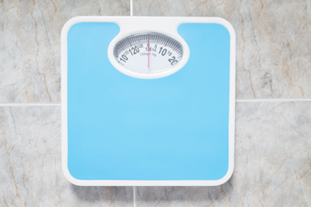


Nutritional Wellness - $100
The recommended daily intake of food and liquids is based on these measures.
Back to Board

Slide 6

Nutritional Wellness - $200
Your fluid limits may depend on how much urine you make and whether your heart or lungs are stressed.
True or False
Back to Board

Slide 7
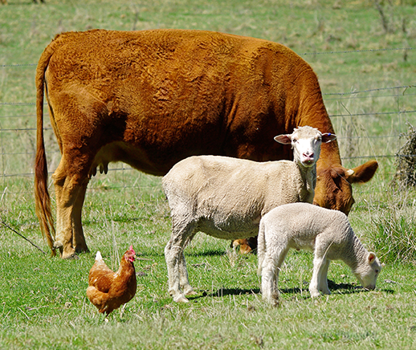
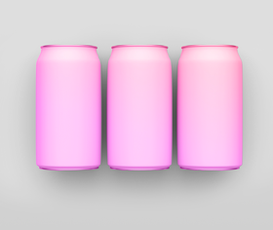
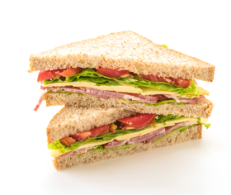
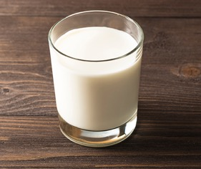
Nutritional Wellness - $300
What are the key nutrients people with CKD need manage in their diet?
Back to Board

Slide 8
Nutritional Wellness - $400
For each color listed below, name one fruit or vegetable that patients with ESRD can eat?
Red
Yellow
Green
Orange
Back to Board

Slide 9
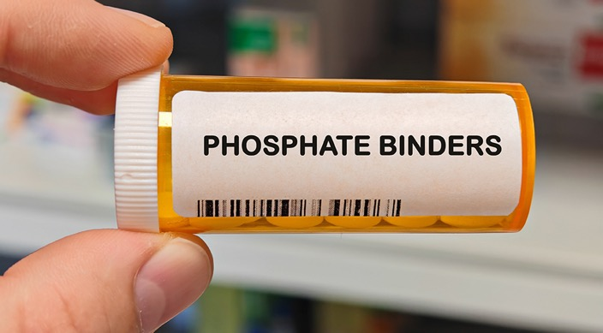
Nutritional Wellness - $500
What are phosphate binders used for and when should you take them?
Back to Board

Slide 10

Physical Activity - $100
Which of these is considered a “low impact,” exercise that’s kidney-friendly
A) Swimming
B) Walking
C) Resistance band exercises
D) All of the above
Back to Board

Slide 11

Physical Activity - $200
Lifting weights doesn’t always mean heavy dumbbells – what common household items can be used as weights for exercise?
Back to Board

Slide 12
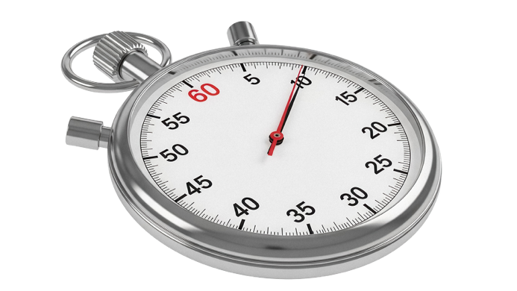
Physical Activity - $300
How many minutes of moderate activity per week is generally recommended for adults?
A) 30 minutes
B) 75 minutes
C) 150 minutes
D) 300 minutes
Back to Board

Slide 13
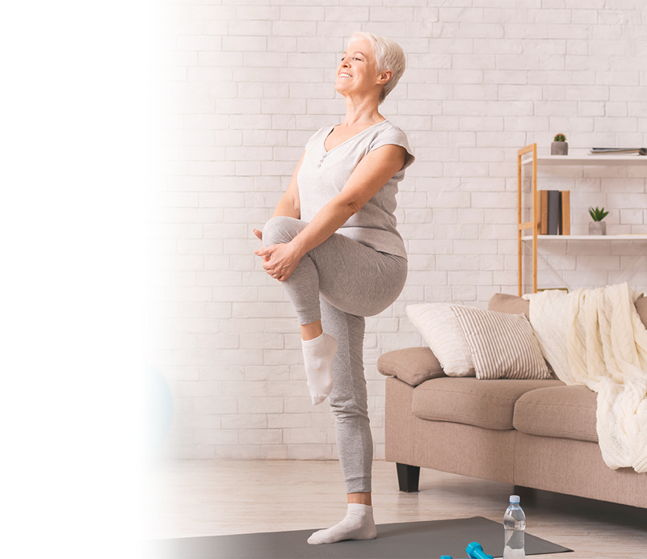
Physical Activity - $400
What are some simple ways to incorporate more physical activity into your daily routine?
Back to Board

Slide 14
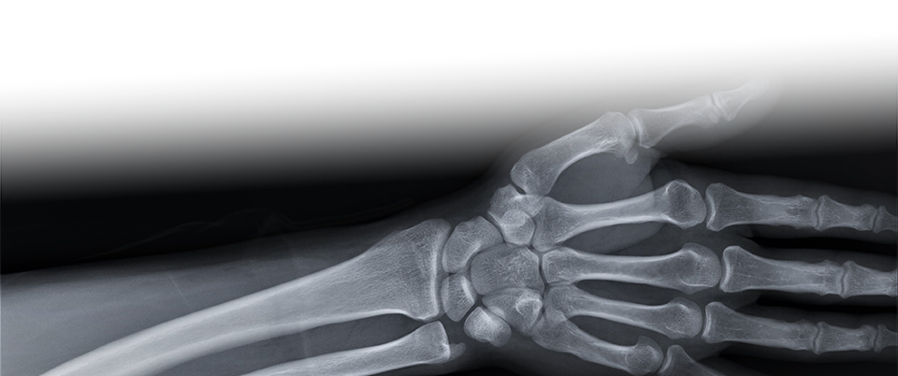
Physical Activity - $500
Why is maintaining bone density through exercise important for ESRD patients?
Back to Board

Slide 15
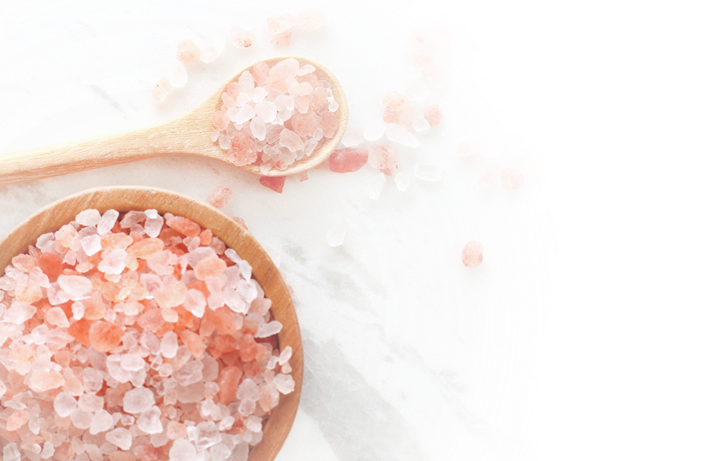
Healthy Choices - $100
Which three minerals should a person on a renal diet limit? Calcium, Potassium, Sodium, Magnesium, Phosphorus, Chloride, or Sulfur?
Back to Board

Slide 16
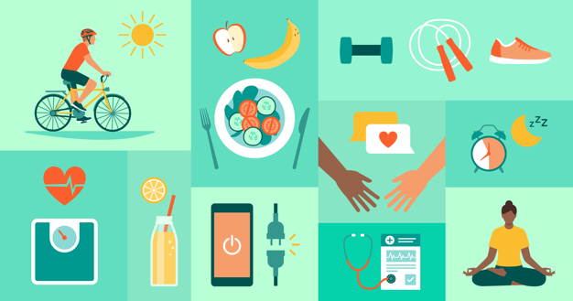
Healthy Choices - $200
True or False: It’s important to focus on all aspects of health and how they connect to be your healthiest self
Back to Board

Slide 17

Healthy Choices - $300
If you are on a fluid restriction, how much weight gain in 2 days can indicate extra fluid in the body?
Back to Board

Slide 18
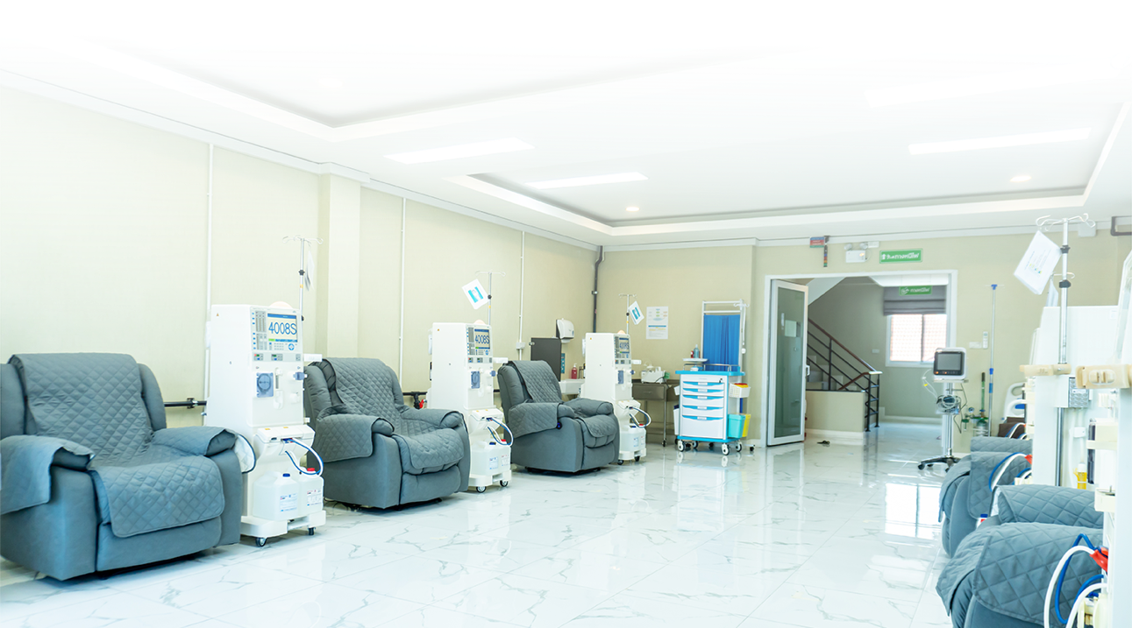
Healthy Choices - $400
How many dialysis treatments can you miss and still maintain optimal quality of life?
Back to Board

Slide 19

Healthy Choices - $500
Your healthcare team comprises various individuals filling different roles. What are the six roles on a dialysis care team, and who’s the MVP?
Back to Board

Slide 20
Answer Sheet
Nutritional Wellness
$100: Your body weight, your age, and guidance from a dietician
$200: True
$300: Sodium, Potassium, Phosphorus, Calcium, Protein
$400: Red: red bell peppers, cherries, strawberries, raspberries, red grapes, cranberries, tomatoes, rhubarb
Yellow - apples, yellow bell peppers, summer squash, yellow onions, pineapples, lemons,
Green - green beans, asparagus, cabbage, cauliflower, lettuce, cucumbers, and zucchini, green grapes, soursop
Orange - mandarin oranges, carrots, tangerines, apricots, sweet potatoes
$500: To manage high phosphate levels in the blood. They work by binding to phosphorus in the digestive tract, preventing its absorption into the bloodstream. They are taken with every meal, every day.
Back to Board

Slide 21
Answer Sheet
Physical Activity
$100: All of the above
$200: Milk or Water bottles/jugs, canned goods, laundry detergent bottles/jugs, paint cans, bags of flour
$300: About 150 minutes, or 30 minutes 5 days a week.
$400: Low-impact water aerobics or swimming
Stairs instead of elevator
Chair aerobics, including cyclers
Tai Chi
Yoga
Walking
$500: Over time, losing calcium from your bones can make them brittle, and calcium that leaves your bones can into your blood and deposit in your blood vessels and heart worsening heart disease
Back to Board

Slide 22
Answer Sheet.
Healthy Choices
$100: Sodium, phosphorus, potassium
$200: True
$300: 2 to 3 kgs or 5 to 7.5 lb
$400: None: each prescribed treatment is necessary to avoid fluid overload, maintain dry weight, and prevent additional damage to the heart, lungs, and body
$500: 1.Patient - Most Important
2. Caretaker/family/friend
3. RD - Dietician
4. MSW - Social Worker
5.Clinic Staff – FA/CC/CM/Nurse/Tech/BioMed
6. MD - Nephrologist
Back to Board

Slide 23
Thank you for playing
Contact : trarrington@ipro.org

