Slide 1


HEALTHY LIVING

Slide 2

Game B – Additional Factors
Categories
Environmental Health
Social Media Influence
Emotional Well-being
Play Game
B

Slide 3
Let’s PLAY!
Instructions
Online play
Make sure that you can interact with me (the host) via audio or chat when connected through the computer
Please mute your line if you are in a place with background noise or are having side conversations
Setup
Divide players into teams or play as individuals
Make sure you have a pen or pencil to write your answer on the answer sheet
To return to the Home Screen, click the Healthy Living Icon at the top Left of the game screen
Gameplay
On their turn, the player or team selects a question, the host reads the question aloud, keeping the answers hidden
Questions can vary from multiple-choice, short answers, true or false or fill-in-the-blank
Player(s) have a set time to write or give their answer
Winner
The game ends after a set number of rounds or when a specific condition is met
Correct answers receive points. The individual or team with the most points, win
If there's a tie, the host can ask a tiebreaker question to determine the winner
Answers can be found by clicking the category title

Slide 4

$100
Additional Factors
Environmental Health
Social Influence
Your Emotional Well-being
$100
$100
$200
$200
$200
$300
$300
$300
$400
$400
$400
$500
$500
$500

Slide 5

Environmental Health - $100
Which season can put ESRD patients at higher risk for dehydration and fluid imbalance?
a) Winter b) Spring c) Summer d) Fall
Back to Board

Slide 6
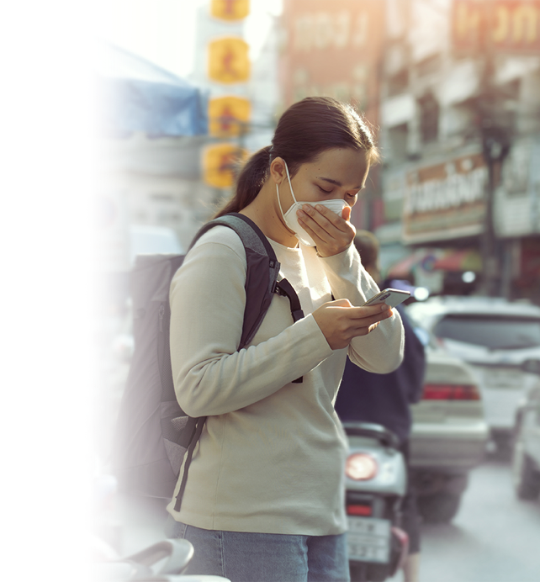
Environmental Health - $200
True or False: Poor air quality can increase the risk of heart and lung problems, which are especially important to monitor in ESRD patients.
Back to Board

Slide 7
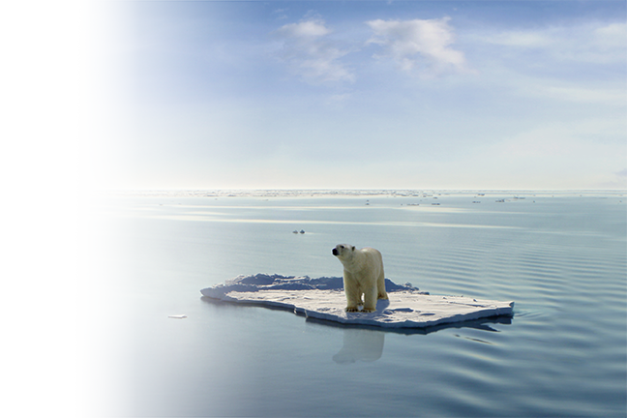
Environmental Health - $300
Which global issue could increase kidney problems in the future due to higher rates of dehydration and heat stress?
Back to Board

Slide 8
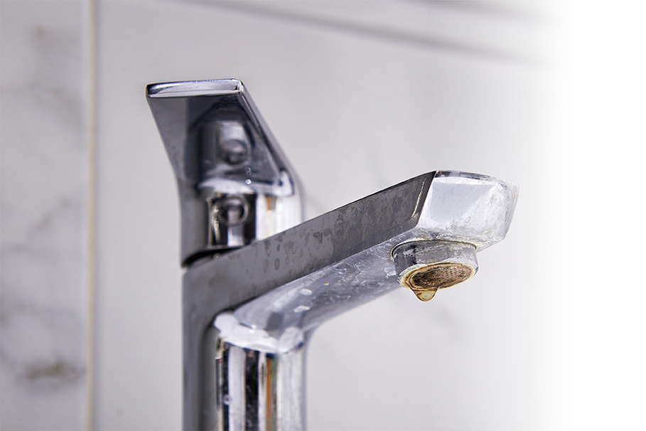
Environmental Health - $400
Water softeners remove some minerals, but the water is still unsafe for dialysis. Which minerals are taken out?
Back to Board

Slide 9
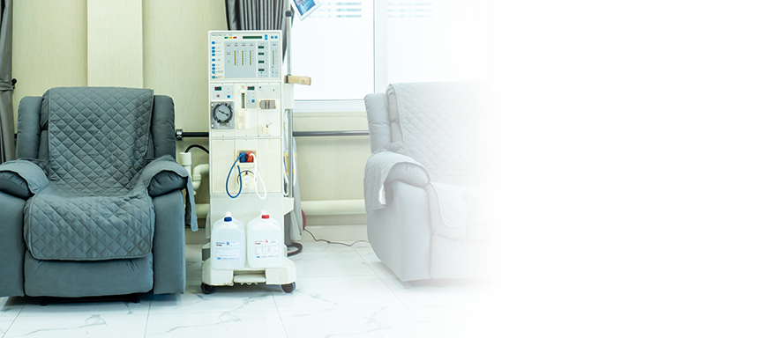
Environmental Health - $500
What is the primary method of filtering water for hemodialysis machines?
Back to Board

Slide 10

Social Influence - $100
Social media can be beneficial for many reasons, including interaction, research, and laughter; however, according to studies, what are some negative effects of excessive social media use?
Back to Board

Slide 11

Social Influence - $200
What does the acronym FOMO stand for?
Back to Board

Slide 12
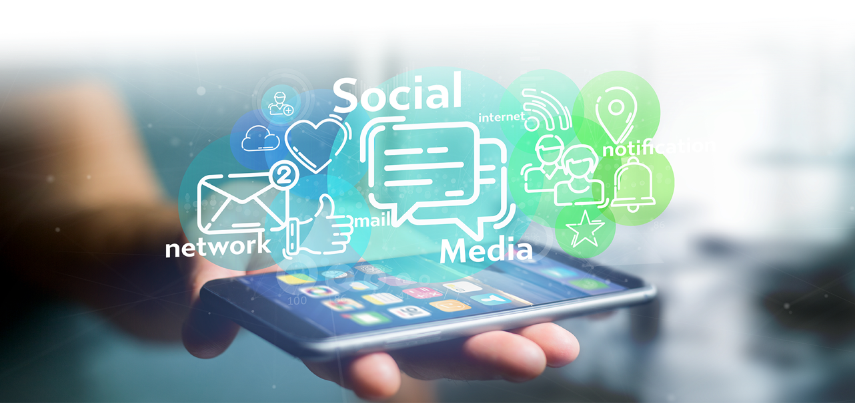
Social Influence - $300
Although there are hundreds of global social media platforms. Name 7 of the major platforms.
Back to Board

Slide 13

Social Influence - $400
Which of these individuals can be the most powerful form of social influence in kidney health?
A) A celebrity talking about it B) A healthcare professional giving advice C) A dialysis patient sharing their personal journey
D) A caretaker helping
Back to Board

Slide 14

Social Influence - $500
Approximately how many people in the U.S. are living with ESRD and on dialysis?
A) 100,000 – 250,000
B) 250,000 – 500,000 B) 500,000 – 800,000 C) 800,000 – and above
Back to Board

Slide 15

Emotional Well-being - $100
Studies show that patients with end-stage renal disease are at a significantly higher risk for which two mental health conditions compared to the general population?
Back to Board

Slide 16

Emotional Well-being - $200
There are many resources and tools you can access for self-help and self-care. What are some ways?
Back to Board

Slide 17
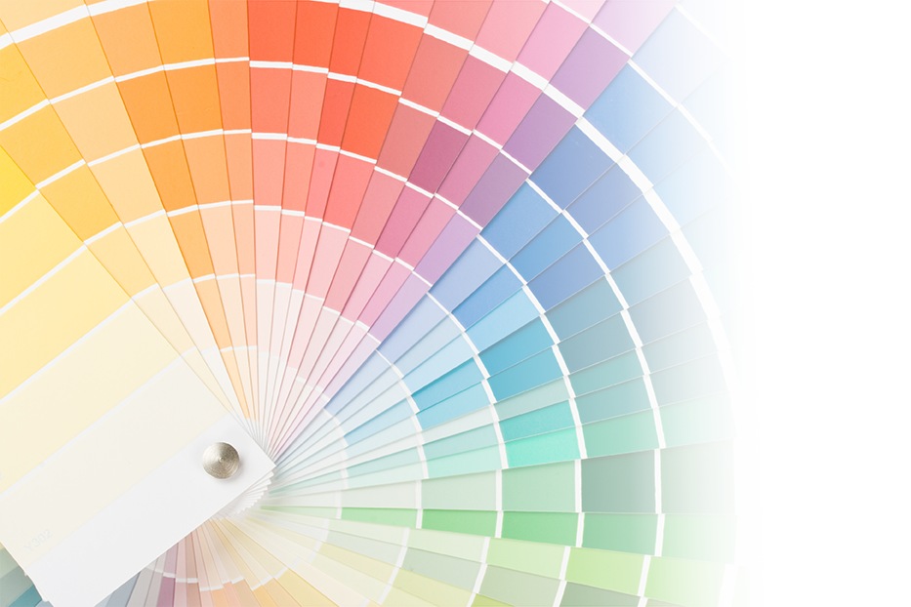
Emotional Well-being - $300
Which color is often linked with feelings of calm and relaxation?
A) Red
B) Blue
C) Yellow
D) Orange
Back to Board

Slide 18

Emotional Well-being- $400
Feeling connected to others is important for emotional well-being. What’s one way ESRD patients can build connections?
Back to Board

Slide 19
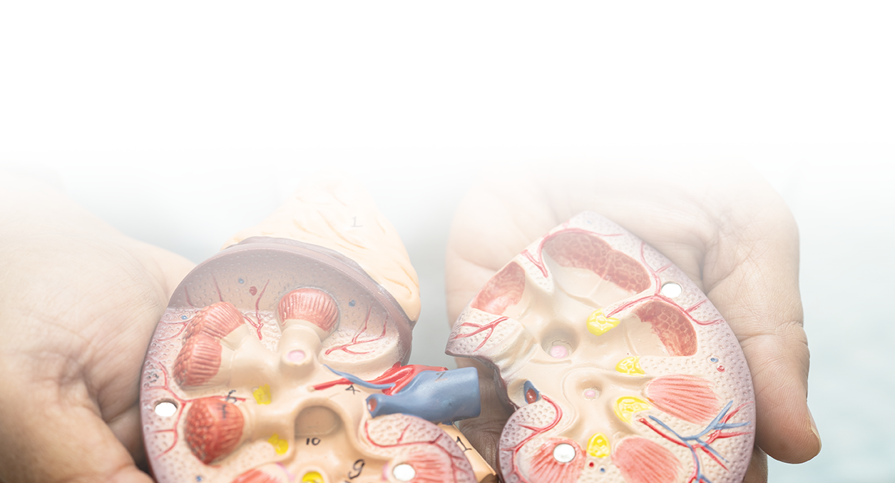
Emotional Well-being - $500
Having kidney disease can add stressors in your life that impact your mental health. If you are on dialysis, you may experience a great deal of stress. What are three common stressors a person living with kidney disease faces?
Back to Board
Notes:
Financial burden of dialysis
Worrying about dialysis impacting your family, work, social and love life.
Time commitment for dialysis
Feeling like a burden to others
Fearing that dialysis may cause pain
Unable to have restful sleep
Changes in employment
Eating restrictions

Slide 20
Answer Sheet.
Environmental Health
$100: C: Summer
$200: True
$300: Climate change and rising global temperatures.
$400: Calcium and Magnesium
$500: Reverse Osmosis
Back to Board

Slide 21
Answer Sheet.
Social Influence
$100: It can lead to an Increased risk of depression, anxiety, loneliness, and decreased self-esteem and or confidence
$200: Fear of Missing Out – feeling of anxiety and restlessness that can result from seeing others’ activities and social interactions
$300: 12: Facebook, YouTube, Instagram, WhatsApp, TikTok, LinkedIn, X (formerly Twitter), Reddit, Snapchat, Nextdoor, Pinterest
$400: C: real stories often inspire the most connection
$500: Over 800,000
Back to Board

Slide 22
Answer Sheet.
Emotional Well-being
$100: Depression and Anxiety
$200: Books, Exercise, Kidney-friendly eating, Religion/spirituality, Sleep, Social network, Support groups, Professional help
$300: Blue - associated with the vast sky and ocean, and research shows it can have physiological effects like slowing heart rate and breathing. It provides feelings of peace, security, and stability, which contribute to its calming effect
$400: Joining a support group, staying in touch with loved ones, or chatting with staff/patients at dialysis)
$500:Financial burden of dialysis
Worrying about dialysis impacting your family, work, social and love life.
Time commitment for dialysis
Feeling like a burden to others
Fearing that dialysis may cause pain
Unable to have restful sleep
Changes in employment
Eating restrictions
Back to Board

Slide 23
Thank you for playing
Contact : trarrington@ipro.org

