Slide 1


HEALTHY LIVING

Slide 2

Game C – What’s the Difference
Categories
CKD, AKI vs ESRD
Home vs In-Center
Transplant
Play Game
C

Slide 3
Let’s PLAY!
Instructions
Online play
Make sure that you can interact with me (the host) via audio or chat when connected through the computer
Please mute your line if you are in a place with background noise or are having side conversations
Setup
Divide players into teams or play as individuals
Make sure you have a pen or pencil to write your answer on the answer sheet
To return to the Home Screen, click the Healthy Living Icon at the top Left of the game screen
Gameplay
On their turn, the player or team selects a question, the host reads the question aloud, keeping the answers hidden
Questions can vary from multiple-choice, short answers, true or false or fill-in-the-blank
Player(s) have a set time to write or give their answer
Winner
The game ends after a set number of rounds or when a specific condition is met
Correct answers receive points. The individual or team with the most points, win
If there's a tie, the host can ask a tiebreaker question to determine the winner
Answers can be found by clicking the category title

Slide 4

What’s the Difference
CKD, AKI
vs
ESRD
Home vs
In-Center
Kidney Transplant
$100
$100
$100
$200
$200
$200
$300
$300
$300
$400
$400
$400
$500
$500
$500

Slide 5
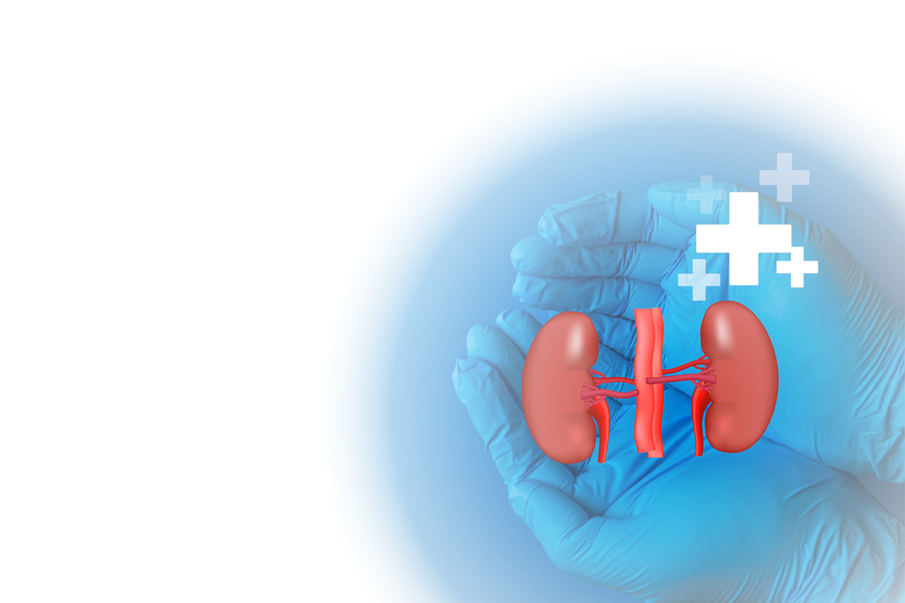
CKD, AKI vs ESRD- $100
What are the two leading causes of chronic kidney disease in the United States?
Back to Board

Slide 6

CKD, AKI vs ESRD- $200
What are two simple tests used to detect early kidney disease?
Back to Board

Slide 7

CKD, AKI vs ESRD- $300
In the early stages, are there noticeable symptoms of chronic kidney disease?
Back to Board

Slide 8

CKD, AKI vs ESRD- $400
What is the final stage of chronic kidney disease, where dialysis or a kidney transplant is required to survive?
Back to Board

Slide 9

CKD, AKI vs ESRD- $500
Is it possible for a patient with CKD to avoid progressing to ESRD?
Back to Board

Slide 10

Home vs In-Center - $100
Which of these are possible benefits of home dialysis?
A) More independence B) Fewer food and fluid restrictions (for some patients) C) Being able to do dialysis while sleeping (for some methods) D) All of the above
Back to Board

Slide 11
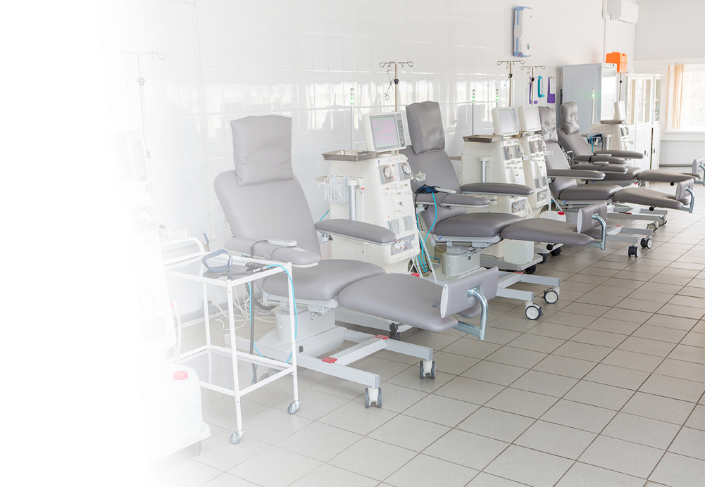
Home vs In-Center - $200
In-center dialysis is usually performed by trained medical staff, while home dialysis is performed by the ______ or a ______
Back to Board

Slide 12
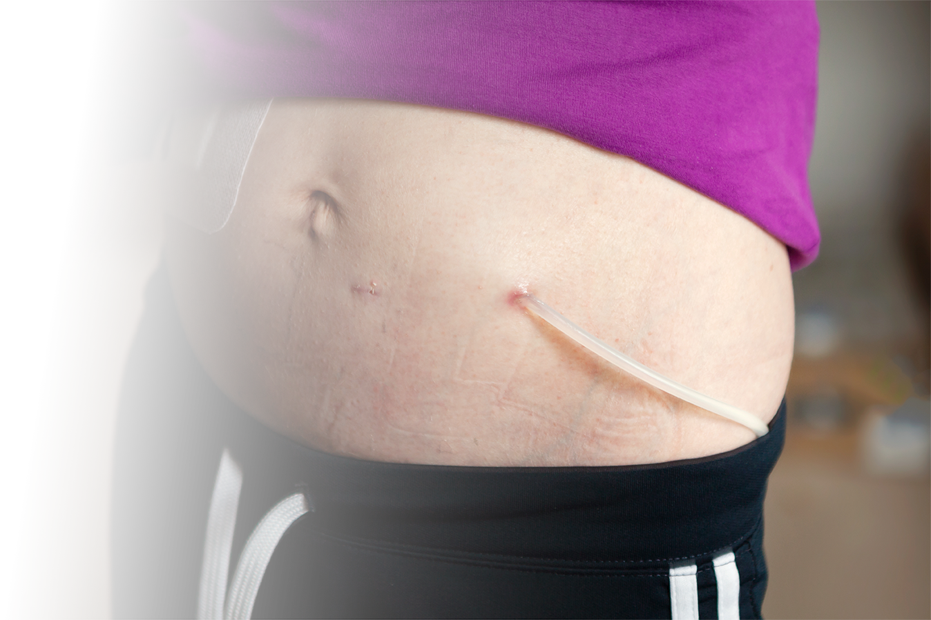
Home vs In-Center - $300
Home dialysis is often done more frequently. Why is that a benefit?
A) It helps control blood pressure better B) It can reduce swelling and cramping C) It may improve overall energy D) All of the above
Back to Board

Slide 13

Home vs In-Center - $400
How does peritoneal dialysis differ from hemodialysis?
Back to Board

Slide 14

Home vs In-Center - $500
What’s one word that best describes the main benefit of home dialysis compared to in-center dialysis? Choose all that apply
a) Flexible
b) Convenient
c) Lonely
d) Independent
d) Inefficient
e) Freedom
Back to Board

Slide 15

Kidney Transplant - $100
Where do kidneys used for transplants come from?
Back to Board

Slide 16

Kidney Transplant - $200
What are some positive health and lifestyle benefits people often experience after a kidney transplant?”
Back to Board

Slide 17

Kidney Transplant - $300
True or False: A kidney transplant is a permanent cure for kidney disease.
Back to Board

Slide 18

Kidney Transplant - $400
A transplanted kidney varies from person to person; what is the average lifespan?
Back to Board

Slide 19
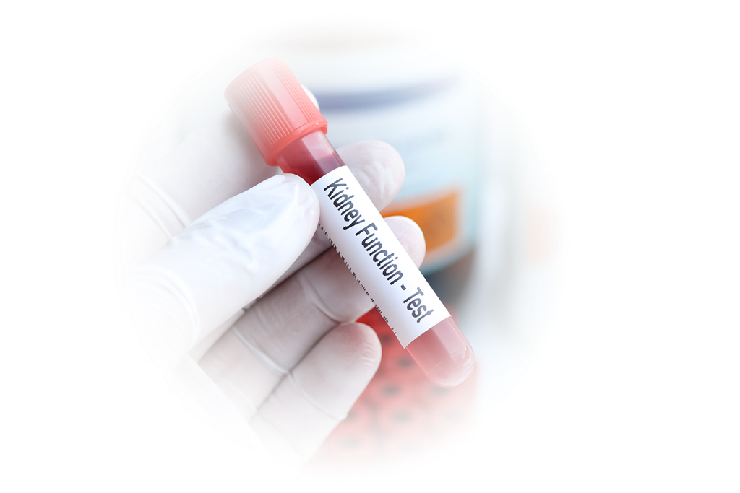
Kidney Transplant - $500
What important test helps determine if a donor kidney is a good match for a patient?
Back to Board

Slide 20
Answer Sheet.
CKD, AKI, ESRD
$100: Diabetes and Hypertension
$200: The estimated glomerular filtration rate (eGFR) (a blood test that estimates kidney filtering ability) and the urine albumin-to-creatinine ratio (uACR) (a urine test that checks for albumin, a protein, that indicates poor kidney filtering).
$300: No, Often there are no noticeable symptoms; however, some individuals may experience increased blood pressure or changes in urination, such as frequent or less frequent peeing
$400: End Stage Renal Disease (ESRD)
$500: Yes, it's possible to avoid or significantly delay progression to end-stage renal disease (ESRD) with proper management of Chronic Kidney Disease (CKD)
Back to Board

Slide 21
Answer Sheet.
Home vs In-Center
$100: All of the above
$200: Patient or the caregiver
$300: All of the above
$400: Peritoneal dialysis (PD) uses the lining of the abdomen as a filter, in contrast, hemodialysis (HD) uses an external machine to filter blood outside the body, typically requiring a clinic or center visit and direct access to blood vessels, often through needles
$500: A, B, D, E - Flexible, Independent, Freedom, Convenient
Back to Board

Slide 22
Answer Sheet
Kidney Transplant
$100: Living and non-living donors
$200: People often feel more energy, enjoy fewer diet and fluid limits, and no longer need dialysis treatments. Many also notice better overall health, improved mood, and more freedom in their daily lives.
$300: False: a transplanted kidney can eventually fail, and medication is required to help the transplant
$400: 8 years to 25 or more
$500: Blood test for compatibility/cross-matching (HLA) Human Leukocyte Antigen
Back to Board

Slide 23
Thank you for playing
Contact : trarrington@ipro.org

