Slide 1


HEALTHY LIVING

Slide 2

Game D – Start from the Beginning
Categories
What Kind of Access
Fact or Fiction
Kidney Talk 101
Play Game
D

Slide 3
Let’s PLAY!
Instructions
Online play
Make sure that you can interact with me (the host) via audio or chat when connected through the computer
Please mute your line if you are in a place with background noise or are having side conversations
Setup
Divide players into teams or play as individuals
Make sure you have a pen or pencil to write your answer on the answer sheet
To return to the Home Screen, click the Healthy Living Icon at the top Left of the game screen
Gameplay
On their turn, the player or team selects a question, the host reads the question aloud, keeping the answers hidden
Questions can vary from multiple-choice, short answers, true or false or fill-in-the-blank
Player(s) have a set time to write or give their answer
Winner
The game ends after a set number of rounds or when a specific condition is met
Correct answers receive points. The individual or team with the most points, win
If there's a tie, the host can ask a tiebreaker question to determine the winner
Answers can be found by clicking the category title

Slide 4

What’s the Difference
What’s the Access
Fact
Or
Fiction
Kidney Talk 101
$100
$100
$100
$200
$200
$200
$300
$300
$300
$400
$400
$400
$500
$500
$500

Slide 5

What’s the Access - $100
What’s the name of the tube or vascular access point used for hemodialysis?
A) Catheter
B) Fistula
C) Graft
D) All of the above
Back to Board

Slide 6
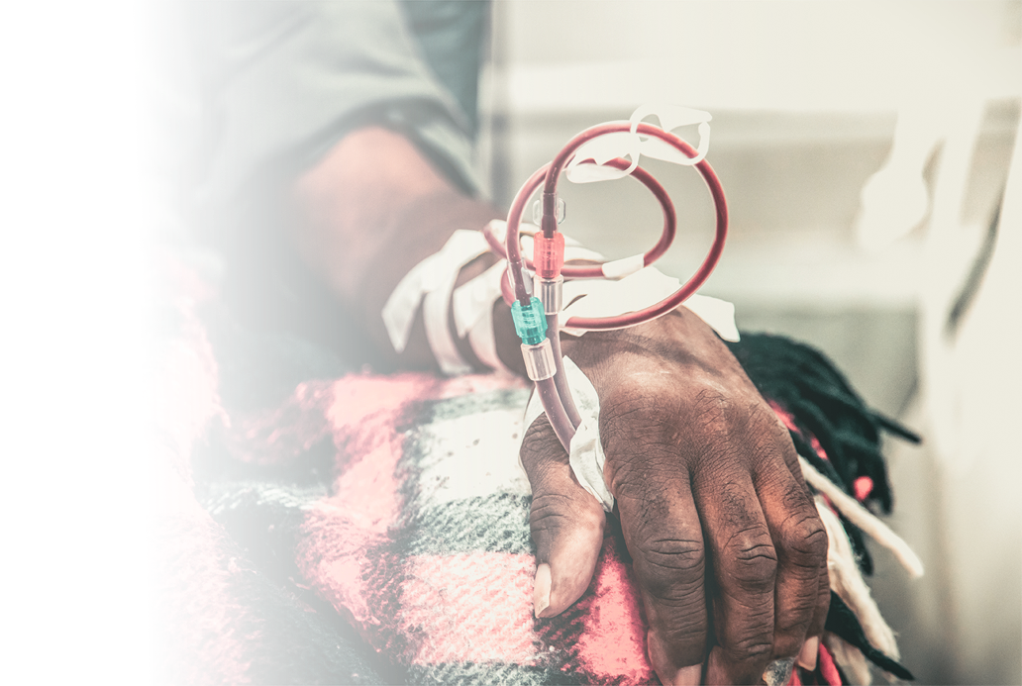
What’s the Access - $200
Which type of vascular access is considered the “gold standard” for long-term hemodialysis?
a) Central venous catheter b) Arteriovenous fistula (AVF) c) Arteriovenous graft (AVG) d) Peripheral IV line
Back to Board

Slide 7

What’s the Access - $300
On average, how long does an AV fistula need to “mature” before it can be used for dialysis?
a) 1–2 days b) 1–2 weeks c) 6–8 weeks d) 6 months
Back to Board

Slide 8

What’s the Access - $400
True or False: Blood pressure checks and blood draws should be avoided in the arm with a fistula or graft.
Back to Board

Slide 9
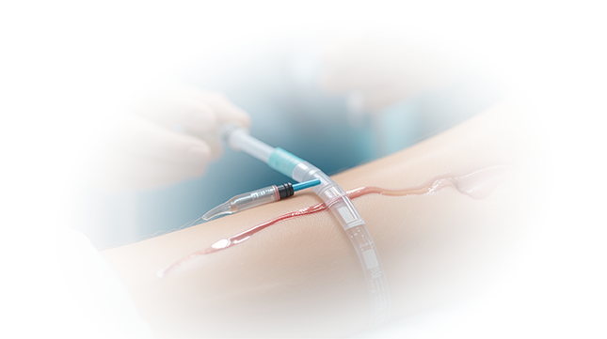
What’s the Access - $500
A fistula or graft that becomes red, hot, or tender may be showing signs of _______
Back to Board

Slide 10
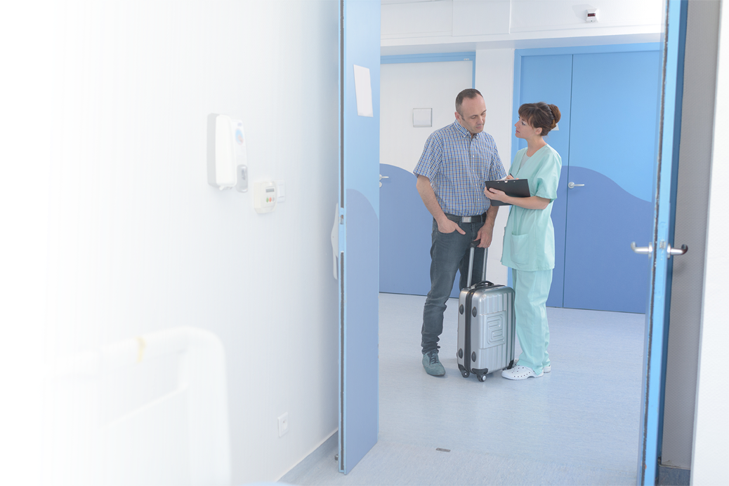
Fact or Fiction - $100
Fact or Fiction: Due to time constraints, dialysis patients can't travel?
Back to Board

Slide 11
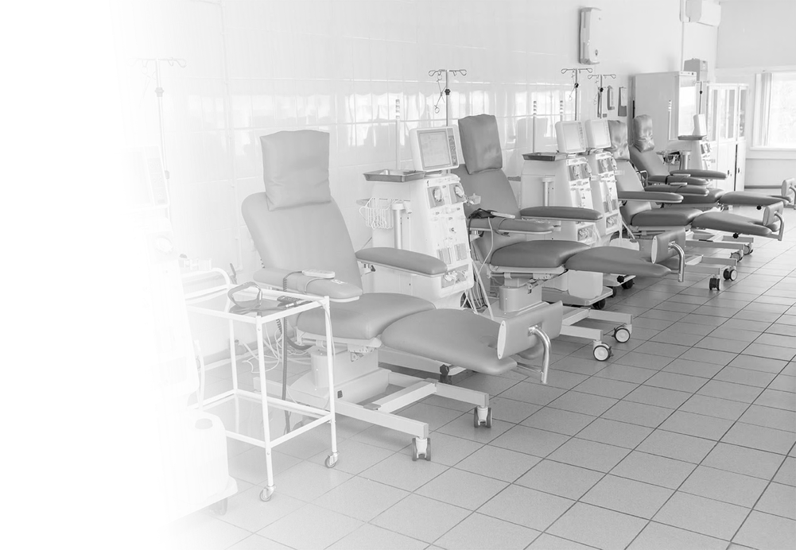
Fact or Fiction - $200
Fact or Fiction: Dialysis patients play an active role in decisions about their treatment.
Back to Board

Slide 12
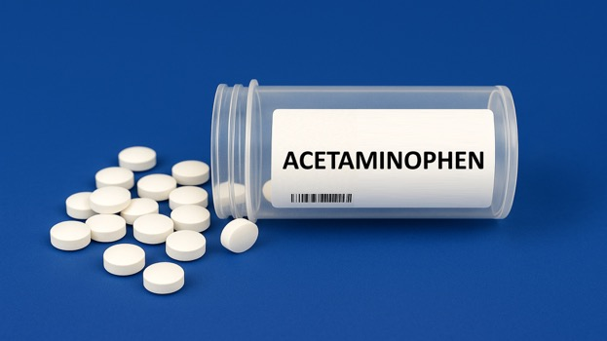
Fact or Fiction - $300
Fact or Fiction: Acetaminophen is the common over the counter pain reliever generally used for ESRD patients?
Back to Board

Slide 13
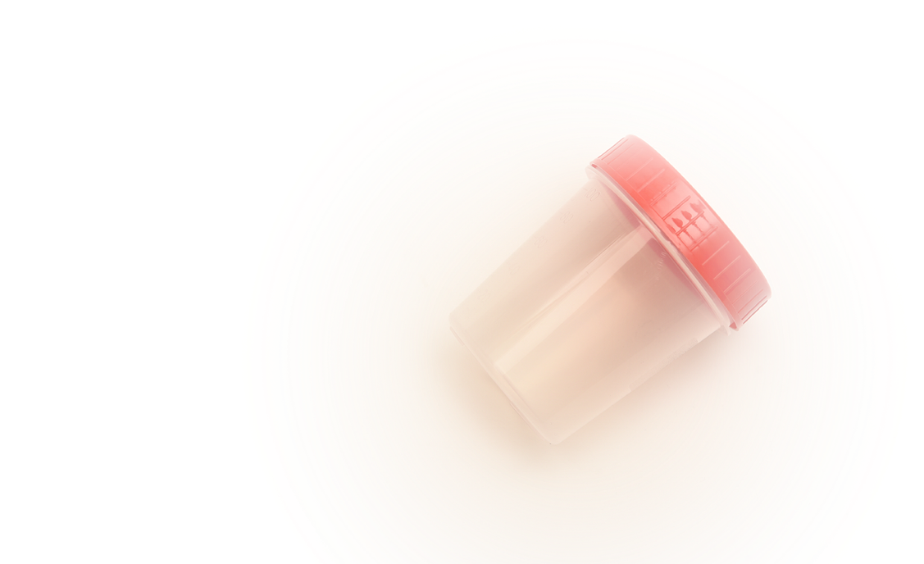
Fact or Fiction - $400
Fact or Fiction: Making urine always means your kidneys are healthy
Back to Board

Slide 14

Fact or Fiction - $500
Fact or Fiction: Older and younger adults get ESRD.
Back to Board

Slide 15
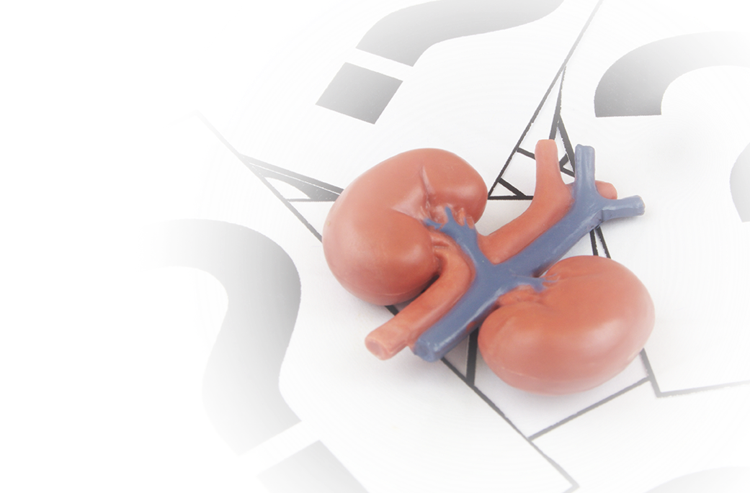
Kidney Talk 101 - $100
What’s the main function of the kidneys?
A) Produce red blood cells
B) Filter waste and extra fluid from the blood
C) Regulate body temperature
D) Aid in digestion
Back to Board

Slide 16
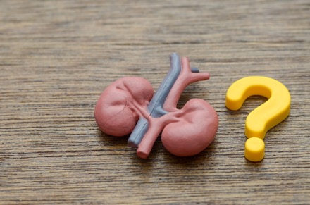
Kidney Talk 101 - $200
What is a common symptom of Kidney disease?
A) Nausea and vomiting
B) Fatigue/shortness of breath
C) Change in urination (more or less)
D) Swelling in the legs/hands/feet
Back to Board

Slide 17
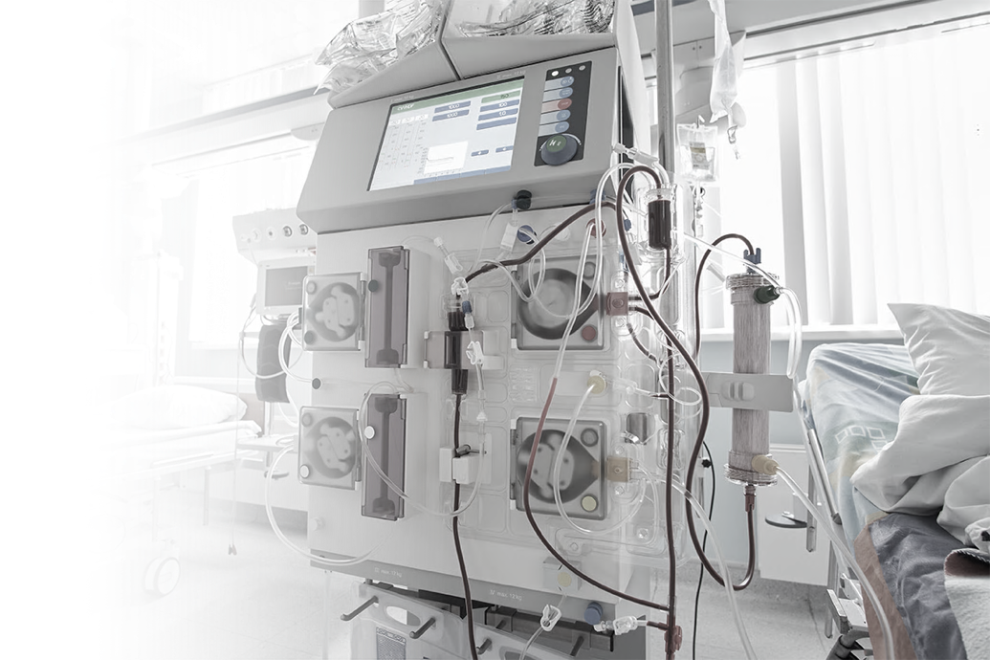
Kidney Talk 101 - $300
The artificial kidney in a hemodialysis machine is called a what?
A) Hemolyzer
B) Nephrolyzer
C) Dialyzer
D) Blood filter
Back to Board

Slide 18
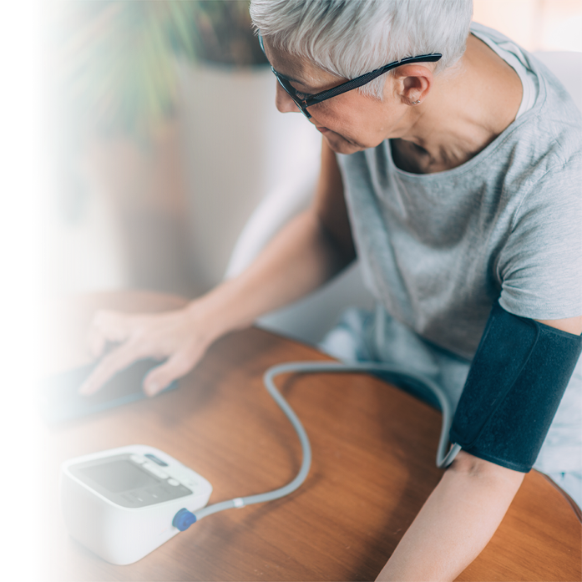
Kidney Talk 101 - $400
What is the medical word for high blood pressure, a common problem for people with kidney disease?
A) Hypotension
B) Hypertension
C) Hyperactivity
Back to Board

Slide 19
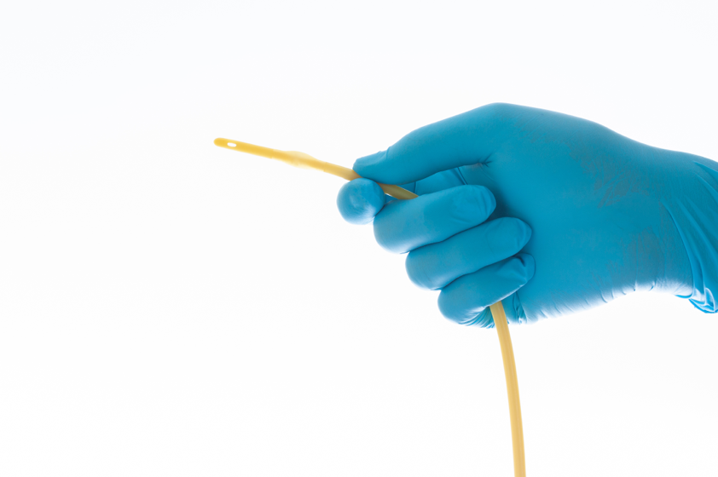
Kidney Talk 101 - $500
What’s the main reason why a catheter is usually considered a temporary access?
Back to Board

Slide 20
Answer Sheet
Whats the Access
$100: All of the above
$200: B: AVF Arteriovenous Fistula
$300 C : 6 to 8 weeks, healthcare staff are to look for signs of infection, listen to the bruit and feel for the thrill
$400: True: BP’s should be avoided on the arm with the fistula or graft to avoid clotting and narrowing
$500: Infection
Back to Board

Slide 21
Answer Sheet
Fact or Fiction
$100: Fiction: Dialysis centers are located in every part of the United States and in many foreign countries. The treatment is standardized. You must make an appointment for dialysis treatments at another center before you go. Your facility social worker can inform you about what you need to do.
$200: Fiction: You as a patient have a great deal of control over your treatments. Patients have a bill of rights which includes quality care, privacy, medical information, social work and dietary counseling
$300: Fact: Acetaminophen is broken down by the liver not by the kidneys. Medications that are NSAIDS (ibuprofen, naproxen, aspirin, etc) can reduce blood flow to kidneys.
$400: Fiction: Urine production might still be occurring but it is not the quality or quantity you need
$500: Fact: While risk increases with age, children and young adults can also develop ESRD due to genetic, autoimmune, or other health conditions.
Back to Board

Slide 22
Answer Sheet.
Kidney Talk 101
$100: Filter waste and extra fluid from the body
$200: All the above
$300: Dialyzer
$400: Hypertension
$500: It has a higher risk for infections and clotting.
Back to Board

Slide 23
Thank you for playing
Contact : trarrington@ipro.org

